Slide 1

Group 5
EXCEL,SQL
PROJECT
19 July, 2024

Slide 2
We extend our heartfelt gratitude to ExcelR Institution for the incredible opportunity to work on the Excel and SQL Data Analyst project. This experience has been invaluable, significantly enhancing our skills and knowledge.
Your guidance and support have been instrumental in our professional growth, and we are truly thankful for the resources and encouragement provided by the ExcelR team.
HELLO!

Slide 3
SQL
PROJECT

Slide 4








main
RestaurantID INT RestaurantName VARCHAR(255) CountryCode INT City VARCHAR(255) Address VARCHAR(255) Locality VARCHAR(255) LocalityVerbose VARCHAR(255) Longitude DOUBLE Latitude DOUBLE Cuisines VARCHAR(255) Currency VARCHAR(255) Has_Table_booking VARCHAR(255) Has_Online_delivery VARCHAR(255) Is_delivering_now VARCHAR(255) Switch_to_order_menu VARCHAR(255) Price_range INT Votes INT Average_Cost_for_two DOUBLE Rating DOUBLE YearOpening INT MonthOpening INT DayOpening INT Date DATE
country
CountryID INT Countryname TEXT
Indexes
date
Date DATE Year BIGINT Month BIGINT Quarter TEXT Monthname TEXT
Indexes
Indexes
currency
Currency VARCHAR(255) USD Rate DOUBLE
Indexes

Slide 5
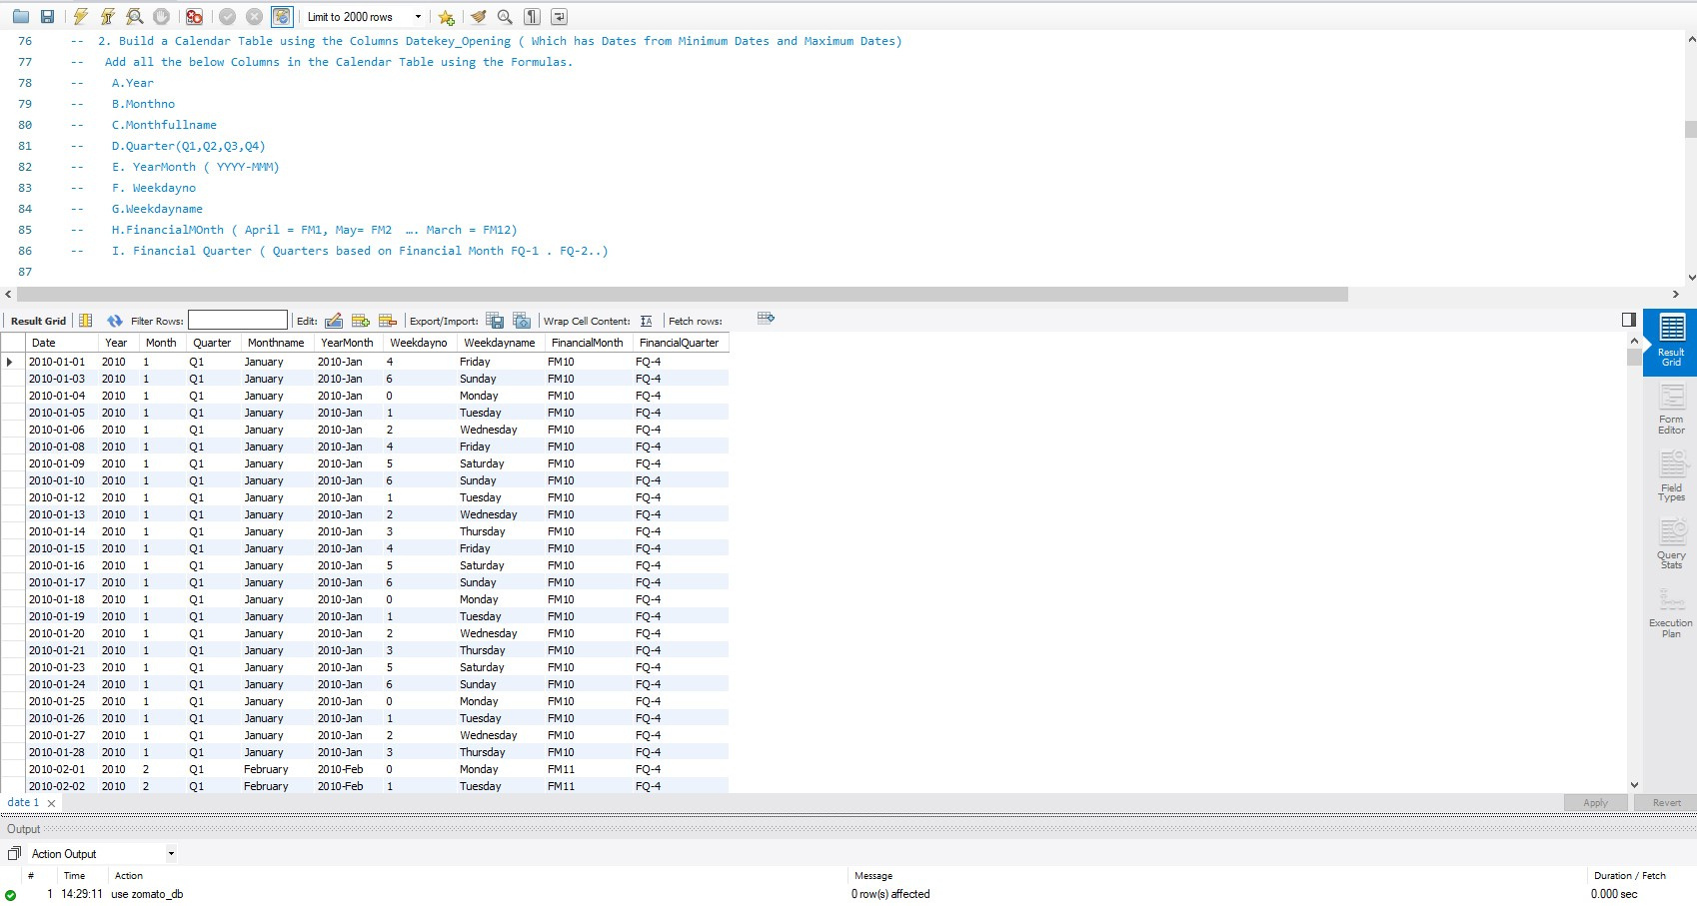

Slide 6
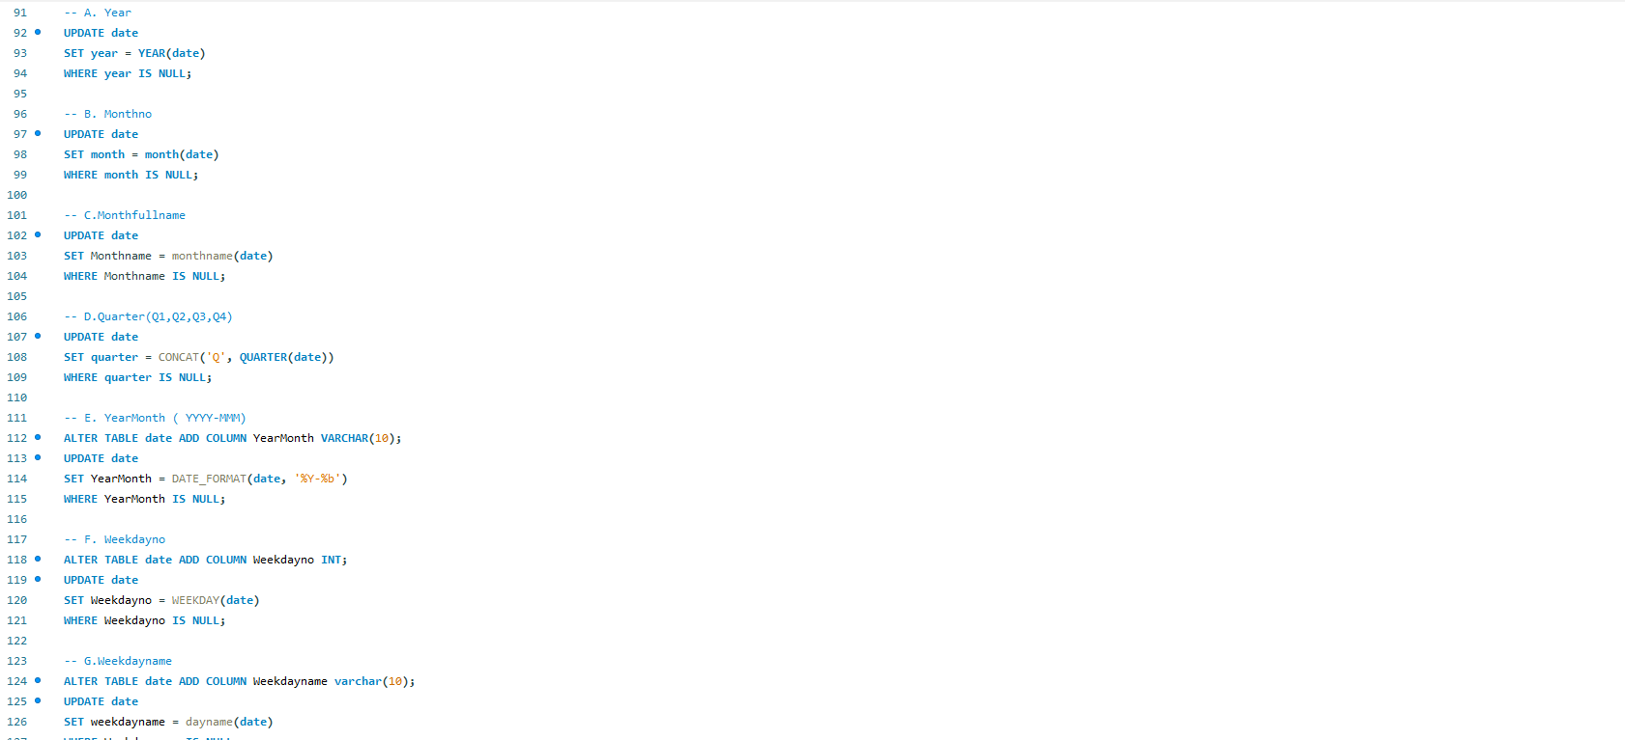
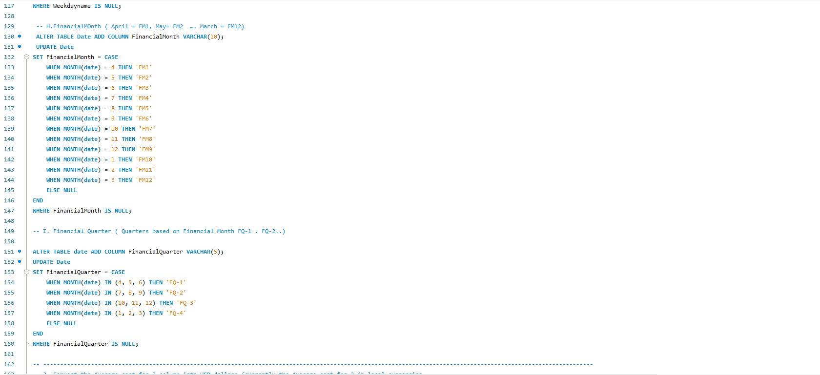

Slide 7
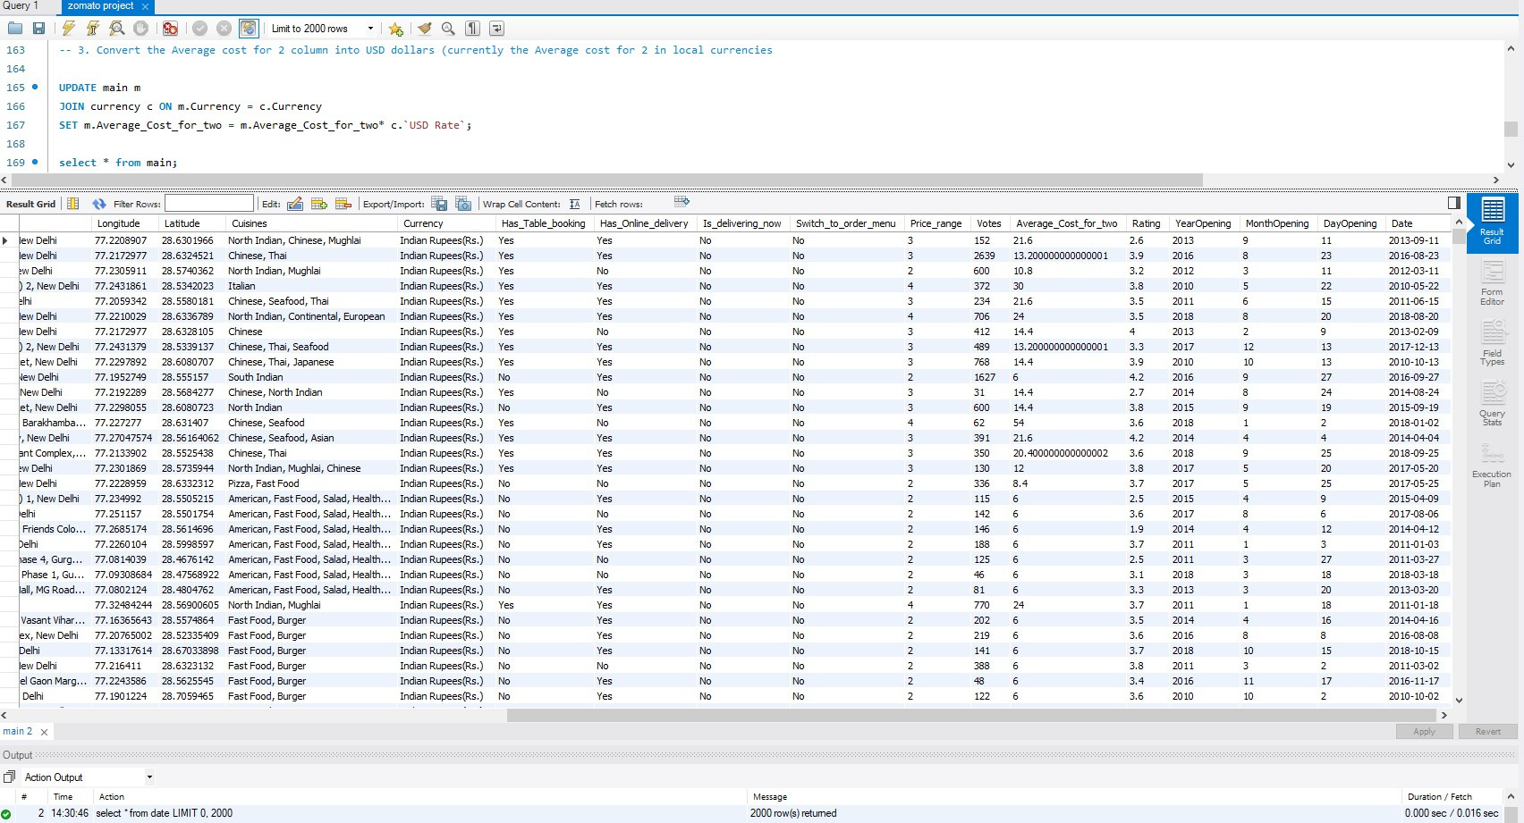

Slide 8
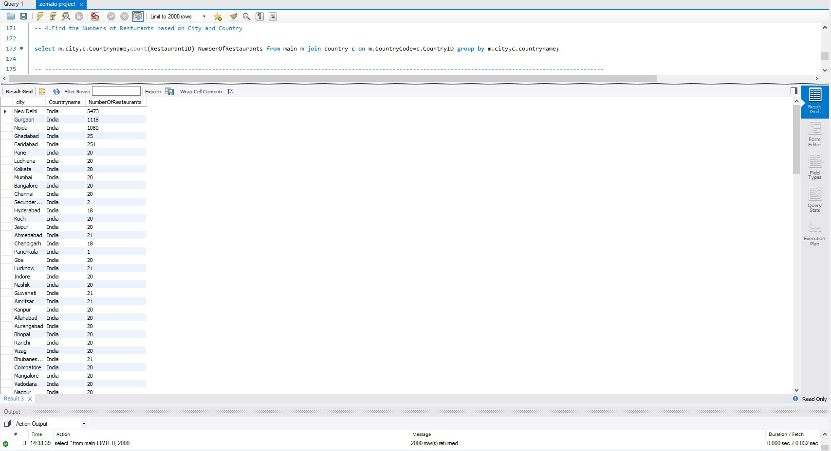

Slide 9
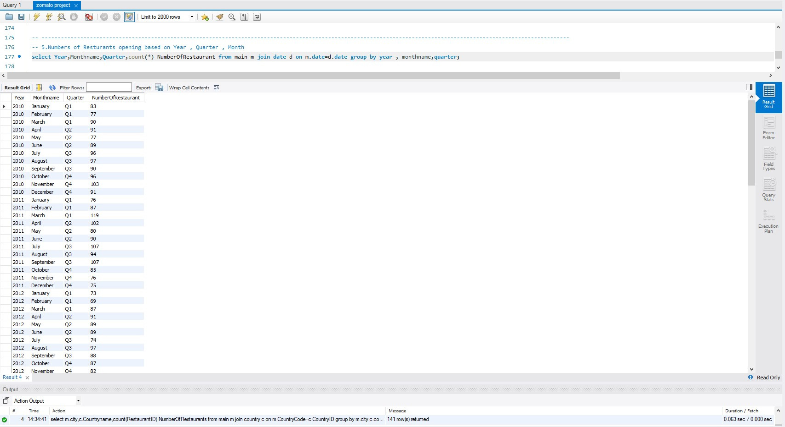

Slide 10
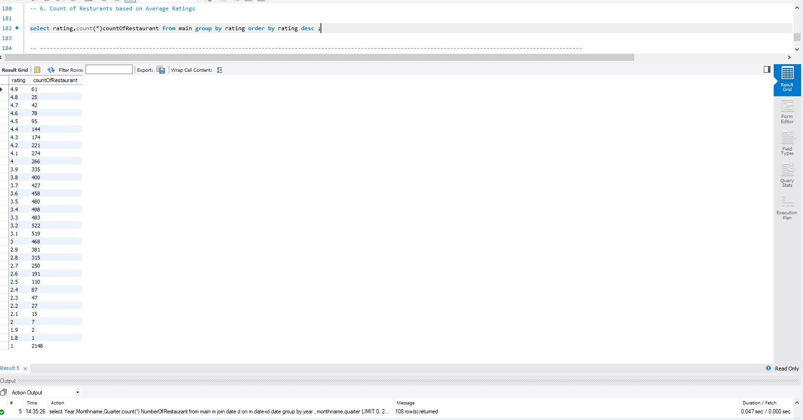

Slide 11
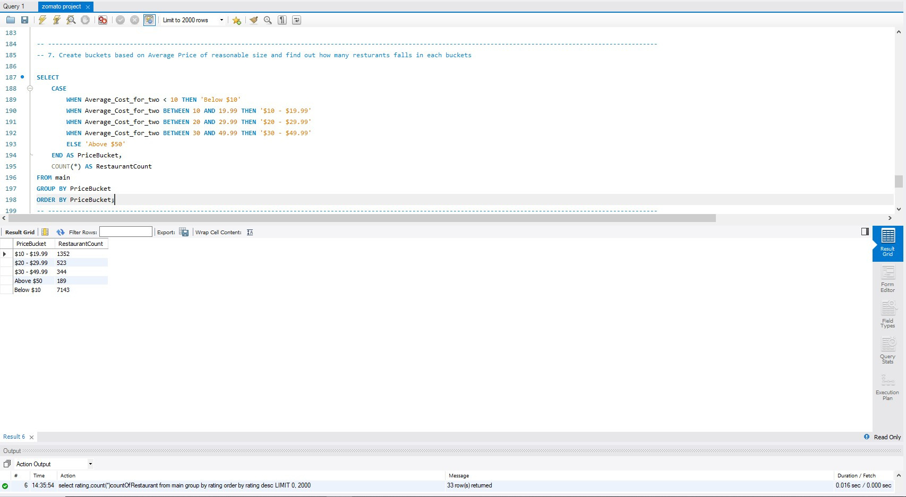

Slide 12
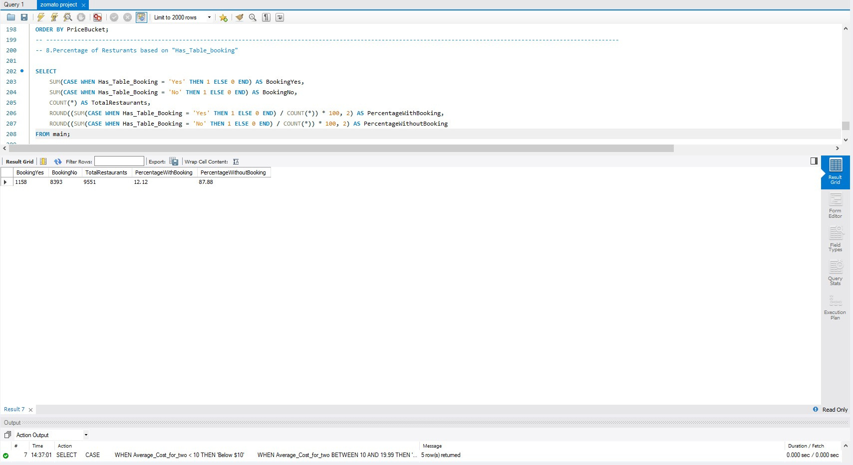

Slide 13
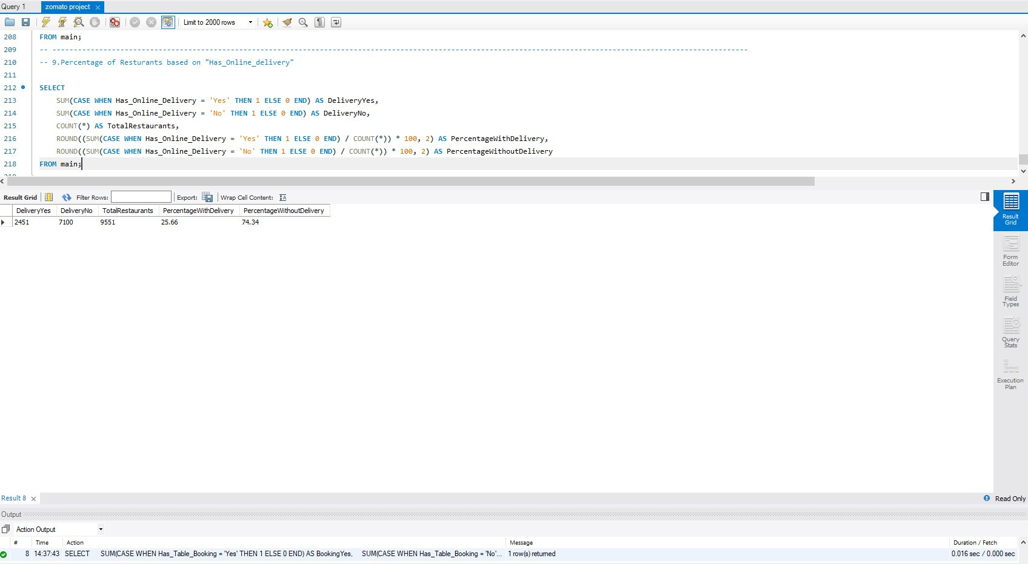

Slide 14
EXCEL
PROJECT

Slide 15
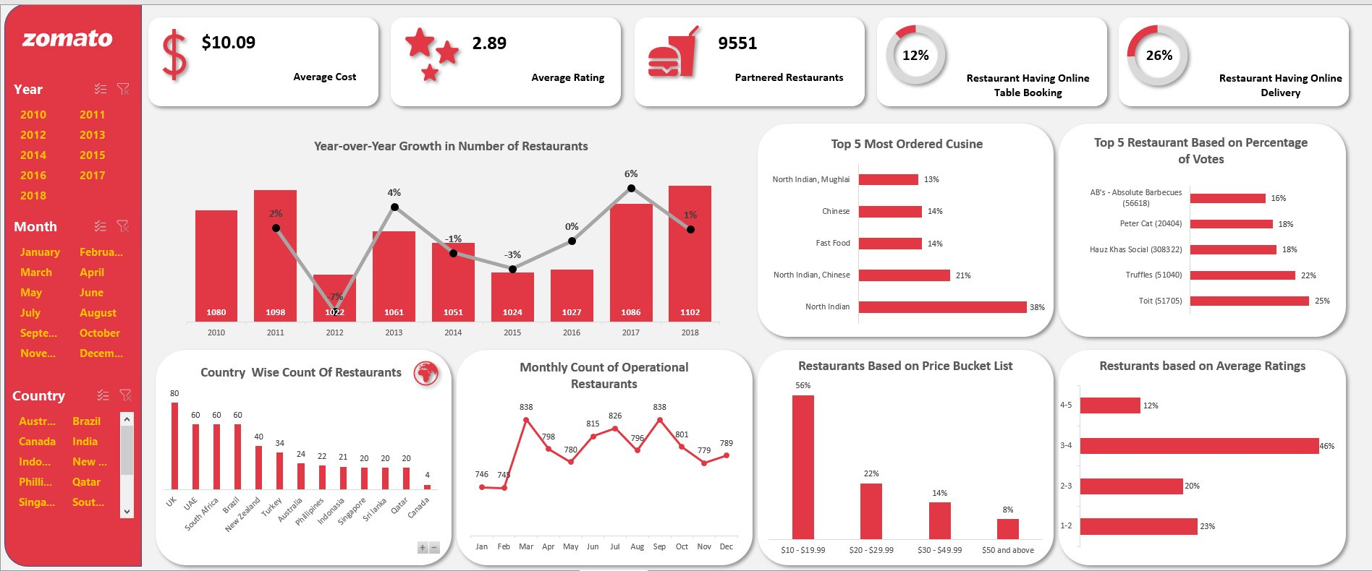

Slide 16
THANK YOU

